Slide 1
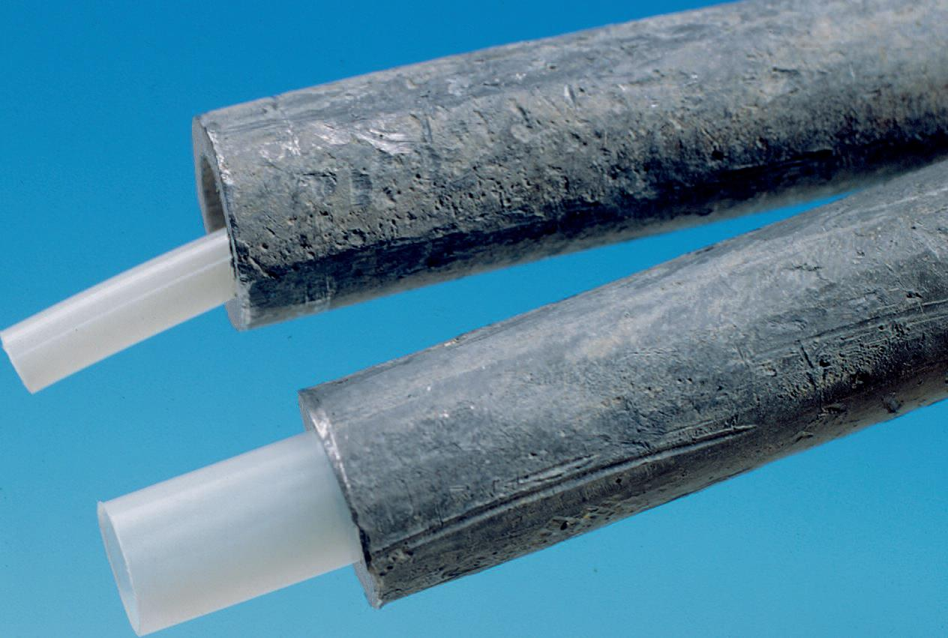
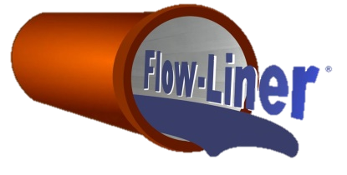
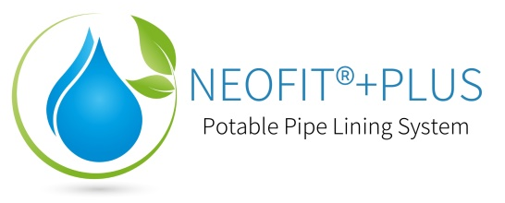
Neofit®+Plus Demonstration & Presentation Potable Water Service Lining System

Slide 2
Contents
1. What is Neofit?
a. NSF 61 Certified
b. Neofit Basics
Neofit Liner Type
Extreme Testing
PET
LCR
2. Case Studies
a. Other Countries and History
France Case Studies
North American Installs
Wessex Water
Louisville
Calgary
3. Installation
a. Basic Setup
b. Timeline
c. Construction Process
d. Lining at Valves
e. Cleaning
f. Video
Finished Installations
4. Costs & Comparisons
a. Estimated savings
Warranty
5. Q&A Session

Slide 3
NSF/ANSI 61 Certified
The Water Quality Association has issued certification for Neofit to the standards of NSF 61/ANSI 61 and NSF 61/ANSI 372

Slide 4
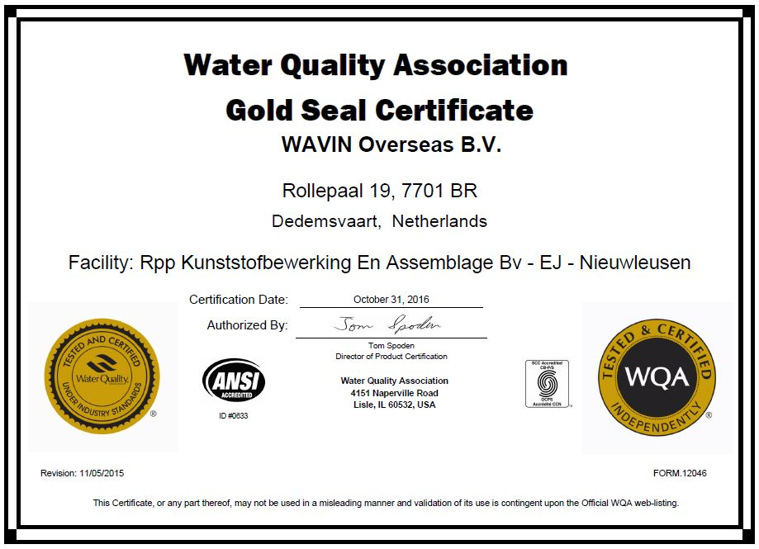
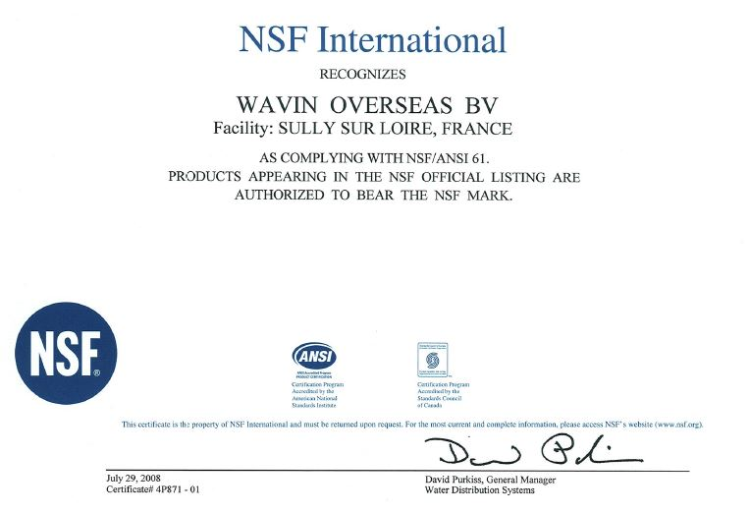
NSF/ANSI 61 Certified
The Water Quality Association has issued certification for Neofit to the standards of NSF 61/ANSI 61 and NSF 61/ANSI 372

Slide 5
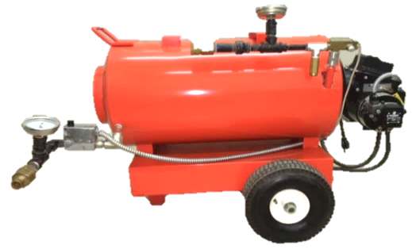
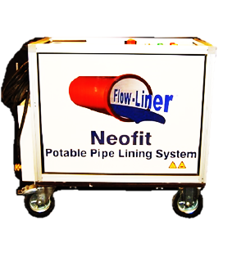
What is Neofit? – The Basics
Neofit (Virgin PET: Polyethylene Terephthalate) is a cost-effective, trenchless, non-invasive, semi-structural pipe lining system for existing water service lines. Neofit helps maintain the existing service pipe by re-lining, not by replacement. Its purpose is to create a safe barrier in existing lead or copper service piping, extend the existing service pipe’s life, or to seal leaks and pinholes. Designed for ½” to 2” ID and up to 300ft sections.
U.S. Patent No. 8,807,171

Slide 6
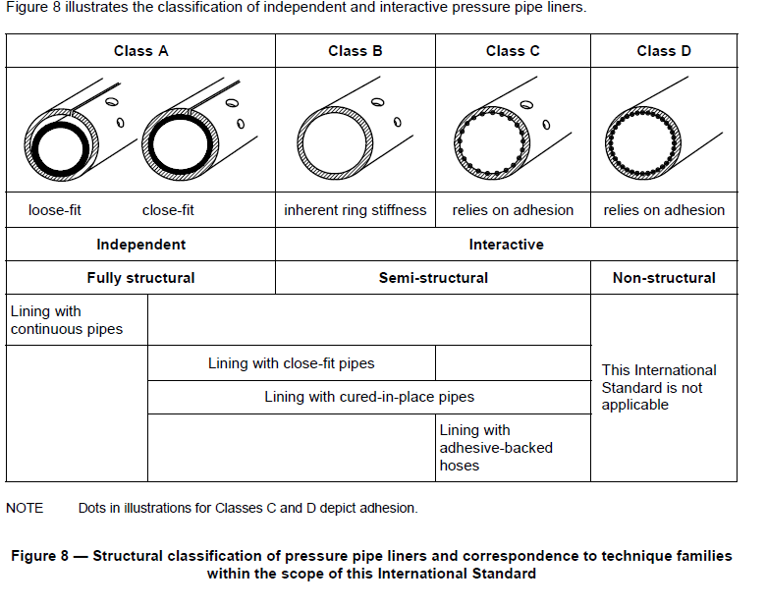
What is Neofit? – The Liner
Neofit is not a coating technology.
Neofit liner is classified as an interactive semi-structural liner Class B, Close fit that does not need to rely on adhesion.

Slide 7
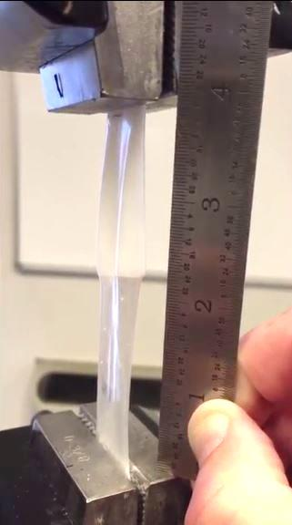
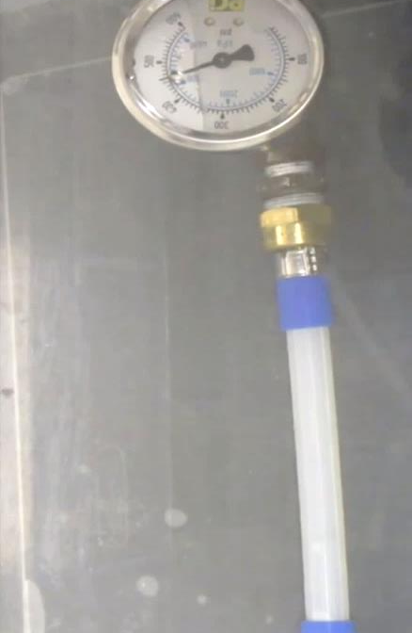
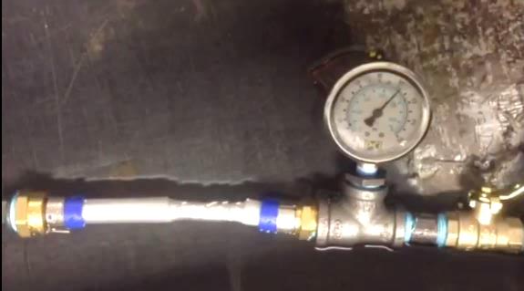
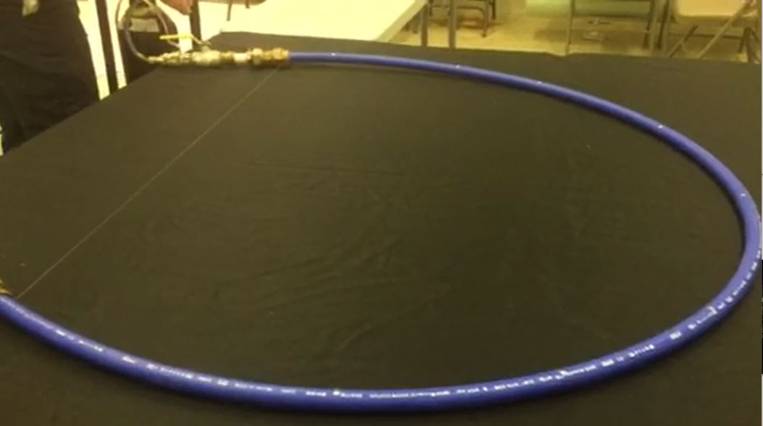
Neofit Extreme Testing
3) Expanded Stand Alone Neofit Liner Stretched- Doubles Length
2) 460psi Burst Test, Expanded Stand Alone Neofit Liner
Leak Test
Burst Tests
Tensile Test
Stressed & Stretched
4) 105psi Burst Test, Expanded & Stretched Stand Alone Neofit Liner Under Pressure
1) 150psi Leak Test Neofit Liner

Slide 8
What is Neofit?
PET
Chemistry - Virgin PET Only- 4X Stronger than the common water bottle and has no recycled material in it and is NSF-61 approved.
Recycled PET has been used for soda and water bottles since the early 1980s with no reports of any short term or long term health issues to humans.
Long-term effectiveness of Neofit
Neofit’s design life is the exact same as new plastic pipe under ISO standards
TOCS, VOCS & NSF 61
TOCS and VOCs are no issue for virgin PET, and the NSF certifications proves it
Chlorine-WRF/EPA Study 2016 (see next slide)
Residual Free Chlorine & Free Chlorine Demand – Decreased with each exposure.
Unlike coating technologies, there is minimal chlorine demand- Better than replacement!
“The chlorine demand exerted by the PET liners in this study was much lower than that observed in the control pipe sections”
Plastic Leachates
Recycled PET vs Virgin PET -- No risk with Virgin PET!
PET in Medical Devices

Slide 9
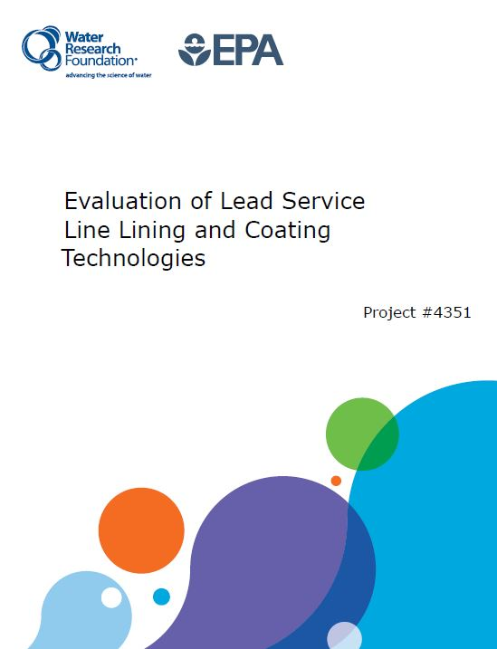
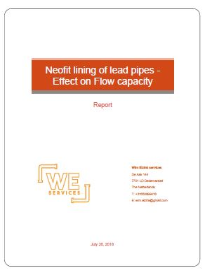
PET Lining
For more technical information regarding the testing and results of Neofit liner, please refer to the Water Research Foundation’s “Evaluation of Lead Service Line Lining and Coating Technologies” pages 121 – 140.
For further information on flow capacity effects of Neofit+, full report available upon request.
often capacity is increased at optimal expansion due to the smoothness of bore.

Slide 10
Neofit Progression
LCR
Not address but not prohibited
Popularity Increasing / Similar to CIPP
Test Out Option
< 15ppb
Avoid mandatory replacement
First used in Europe in the early 1990s
Introduced to US in 2008 with its first pilot for Louisville Water in Kentucky
Collaboration with WRF from 2013 until report release in 2016 with Neofit analysis
By 2017, US engineers recognizing the validity of Neofit for LSLs
Obtaining state approvals and ASTM Standard in 2018
Neofit’s USA Learning Curve

Slide 11
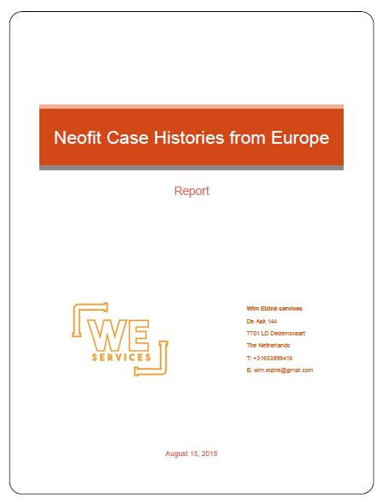
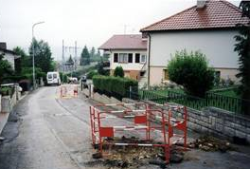
Neofit Case Studies
France: over 200,000 services
In total, exceeding 2000 miles of Neofit lined service pipes
Netherlands, Belgium:
Utilizing Neofit since 1995
Other countries from 2004 on:
Germany, Austria, Australia, Japan Norway, Malaysia, South Africa, Ireland, UK
More information regarding “Neofit Case Histories from Europe” available upon request.

Slide 12
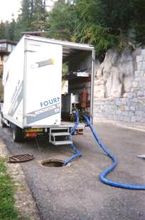
Neofit Case Studies
France
City | # of Services | Installer
Monbéliard | 450 | Generale des Eaux
Dole | 200 | SNCTP
Orléans/Chateaudun | 300 | SAUR
LaTour du Pin | 300 | Fournier TP
Vichy | 200 | CBSE
Cahors | 300 | Capraro & Dubreuilh
Chalons-in-Champagne | 100 | Nord Est TP
Lons-le-Saunier | 100 | Service des Eaux
Pontarlier | 200 | Sté Toubin
Alferink, F. (2009) Neofit Case Histories.

Slide 13
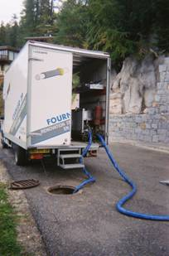
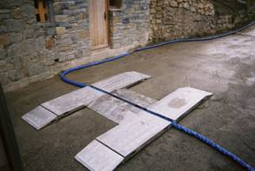
France
Alferink, F. (2009) Neofit Case Histories.

Slide 14
Neofit Case Study- Wessex Water Services
European retesting?
Why not?
Well-established, routine technology
Wessex Water Services
Installation 1991
Pre Installation Lead Levels
75-110ug/l
Post Installation Lead Levels
Weekly to Month Sampling until 1993
Oct 1991- June 1993
100% <7ug/l, 94% <5ug/l
Pre Oct outliers
Satisfaction at 1996
Note: Bacteriological colony counts recorded as low with no differences in comparisons to other homes on same supply source.

Slide 15
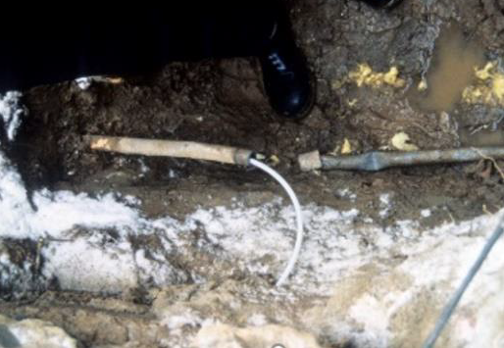
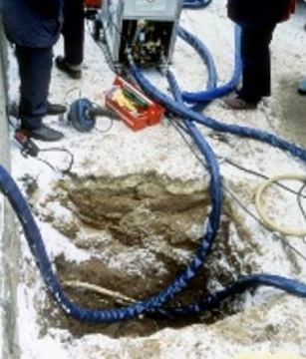
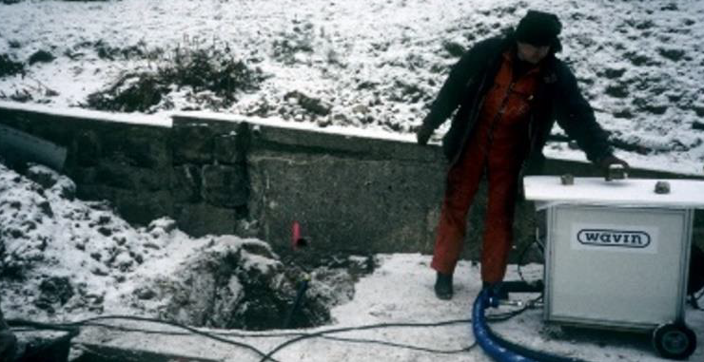
Neofit Case Study- Wessex Water Services
Local water supply (WVW) in Freital, Germany, installed Neofit in 1995.
Still in operation after twenty-three years!
Regularly monitored, the lead content was below 1.0 μg/L.

Slide 16
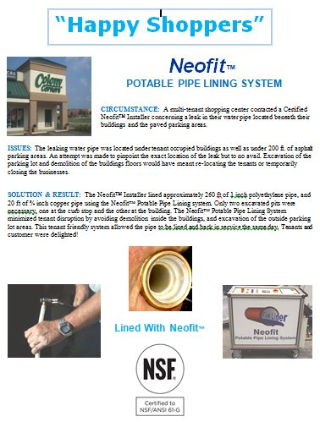
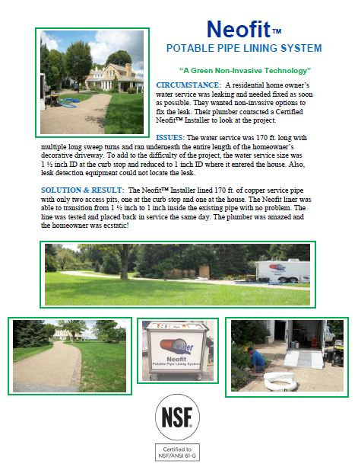
Neofit Case Studies – North America
Several Installations since 2008, some listed below:
Louisville Pilot City of Calgary Pilot
Commercial and Residential Examples

Slide 17
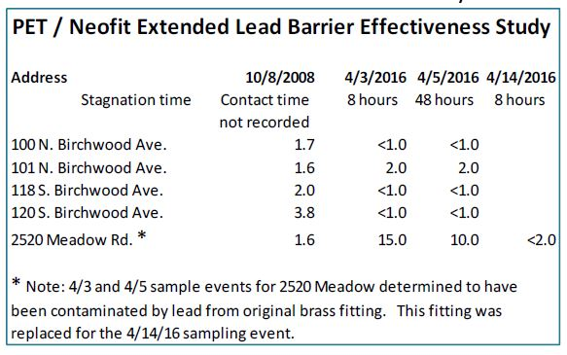
Neofit Case Studies-Louisville
Welter, G. (2016) Pipe coating or lining as alternative strategies for lead service line replacement, 16.

Slide 18
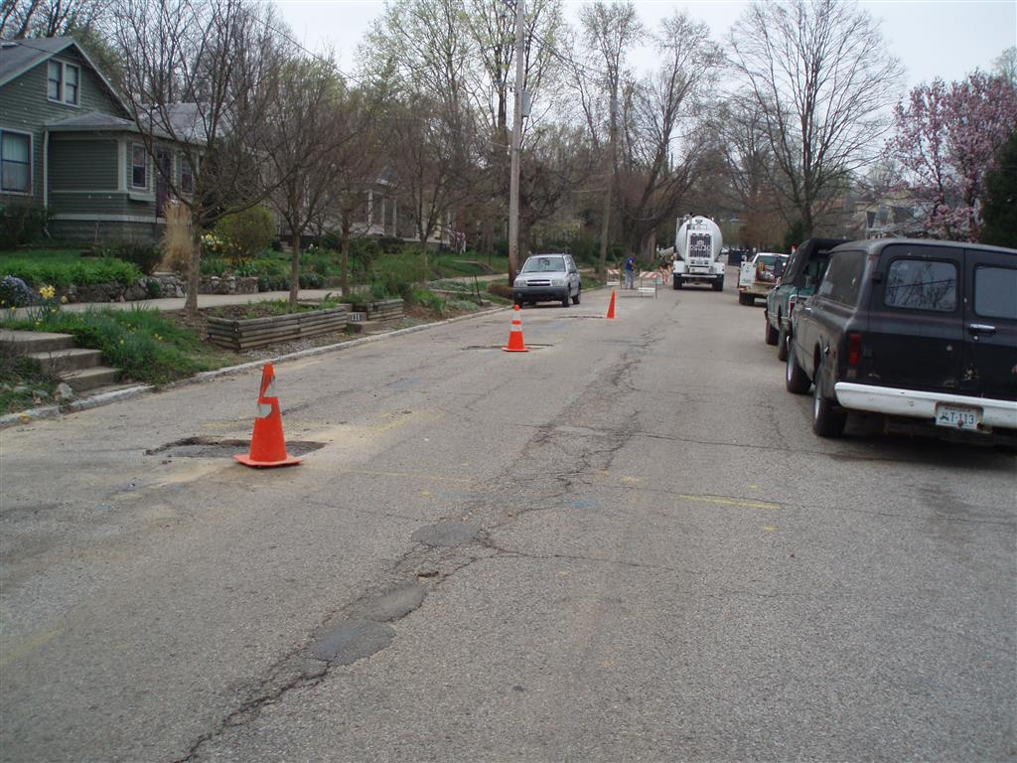
Neofit Case Studies-Louisville
Worst Case Scenario
Stagnant & dormant for 8 years
Isolated for 8 years
Importance of Proper Fittings
2520 Issue
Same for replacement
Ball, T. (2016) Water Quality Sampling Results for Neofit Lined Lead Drinking Water Service Lines, 6.

Slide 19
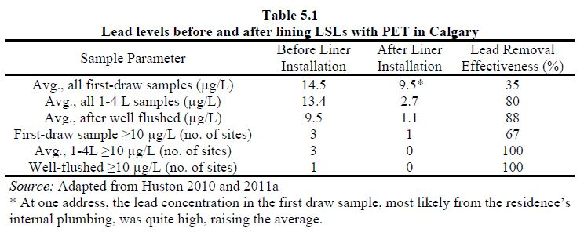
Neofit Case Studies-City of Calgary
2010 Field Trial
Pre & Post Lead Results
Importance of Proper Fittings
Also Addressed In Louisville
Site | Public (ft.) | Private (ft.) | ID (mm) | Type
1017 8th | 46 | 35 | 15 | Lead
428 10th | 46 | 15 | 12 | Lead
424 8thA | 20 | 19 | 15 | Lead
1214 19th | 49 | 14 | 15 | Copper
1925 7th | 46 | 18 | 15 | Lead

Slide 20
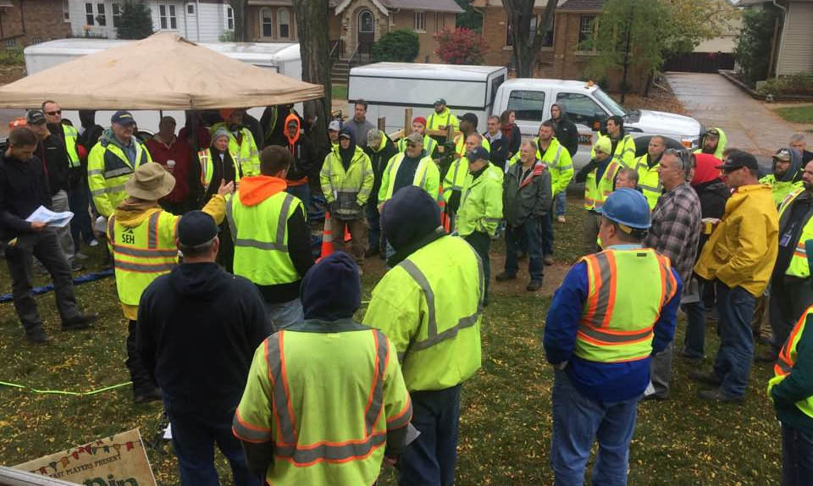
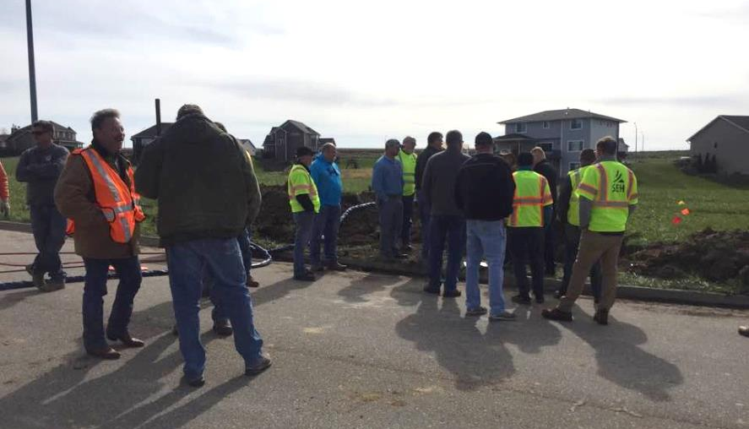
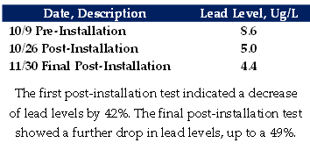
Neofit+ Case Studies – North America
Recent Installations
Approval in Wisconsin and Iowa for Live-Installations
Wauwatosa, WI 1” Lead Water Line
Van Meter, Iowa 1” copper water line

Slide 21
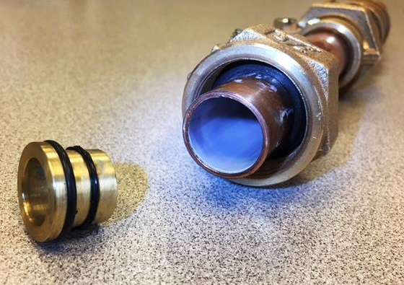
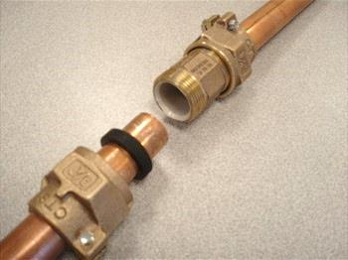
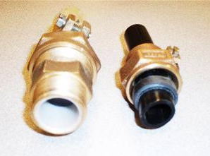
Neofit- Fittings
Calgary & Louisville Fittings –the important of proper fittings

Slide 22
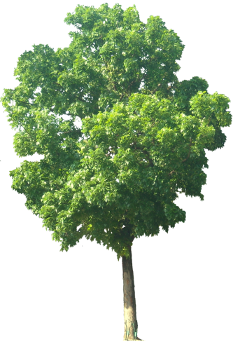
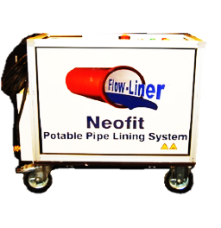
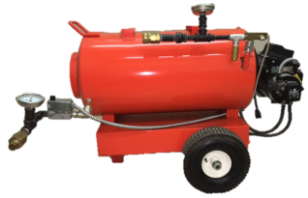
Neofit Basic Installation
The Neofit®+ Plus System Is particularly suitable where alternative solutions prove to be disruptive, such as alongside other infrastructure, under road crossings, in congested ground with other utilities, and in customer properties under drives and gardens. It is also especially beneficial for lining old deteriorating pipes and lines with leaching contaminants, such as lead & copper pipe, as it acts as a barrier.
Neofit® Control Unit
Circulating Hoses
Auxiliary Heating Unit
Municipal Water Supply
House/Building Service Line
Meter in Building
Curb Stop Box/ Access Point
Up to 300ft/91 meters
Installed Neofit® Liner

Slide 23
Neofit Timeline
The Neofit®+ Plus System Timeline (Two person crew- average 50ft install)
Set-up – 30 mins
Cleaning – 30 mins
Lining/Circulating – 60 mins
Reconnect – 20 mins
Clean Up – 10 mins
Total – 2.5 Hours
Estimated 4-5 Installation/Day with multiple crews tackling different steps (see next slide).
Auxiliary Heating System benefits
Neofit® Control Unit
Circulating Hoses
Auxiliary Heating Unit
House/Building Service Line
Drop Meter in Building
Curb Stop Box/ Access Point
Up to 300ft/91 meters
Inserted then Installed Neofit® Liner

Slide 24
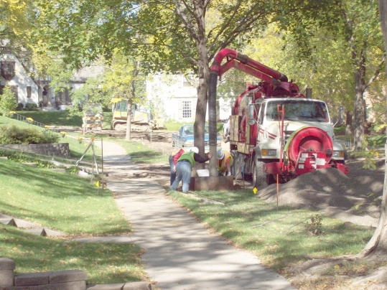
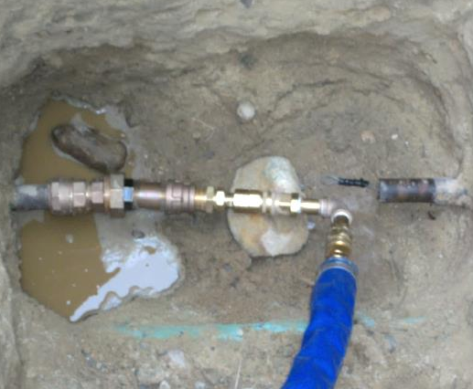
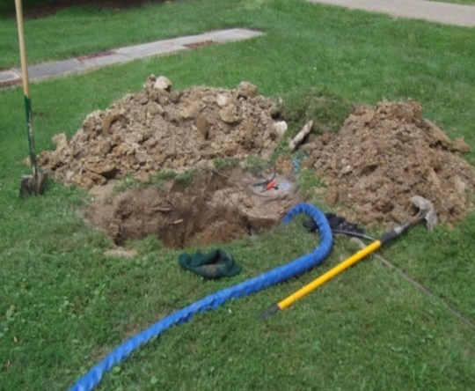
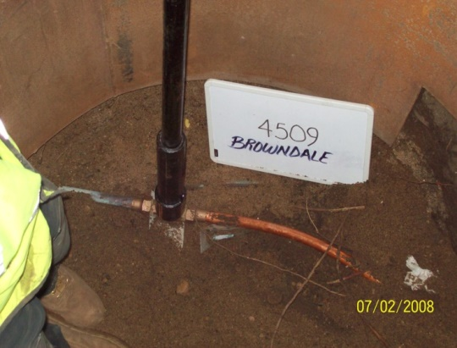
Neofit Ideal Setup
Crew 1
Crew 2
Crew 3
Crew 1- Set-up & Any Necessary Access Pits
Crew 2- Cleaning, Lining, and Expansion Process
Crew 3- Reconnect and Site Clean up

Slide 25
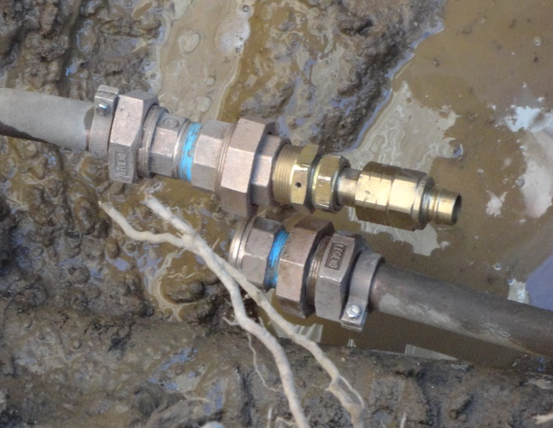
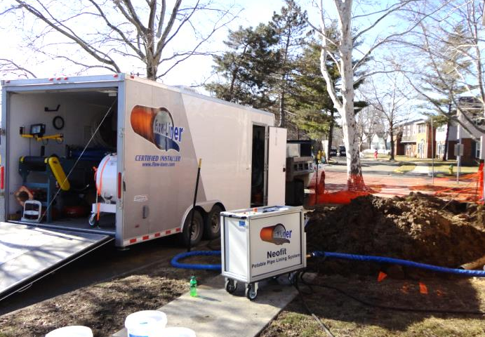
Neofit & Valves
Lining at Valves
Can line through an open valve
Valve cannot be closed once Neofit is installed
Install new valve with Neofit
Install new valve at a different location
At Curb
In Home

Slide 26
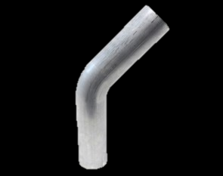
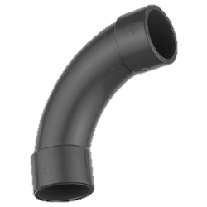
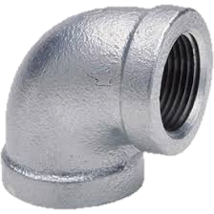
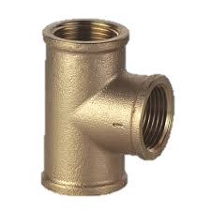
Neofit & Bends
Cleaning and Lining of Bends and Curves

Slide 27
Neofit & Cleaning
Cleaning
Mandrels
Brushes
Cleaning Pigs
Jetting
Not Coating – Neofit does not take hours to complete
Immediate Return to Service
Remove Scale Build-Up
Increase inside diameter
Clear Obstructions
Clear Sharp Obtrusions
Fins found in some lead pipe

Slide 28
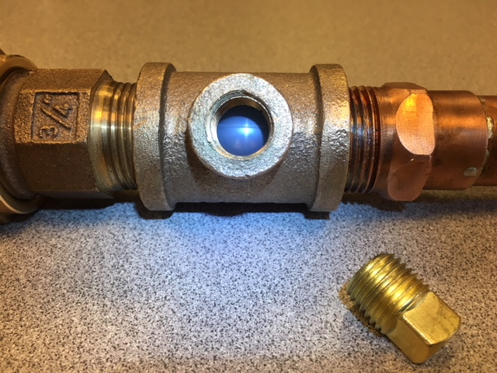
Neofit+ Liner Integrity Test Ports

Slide 29
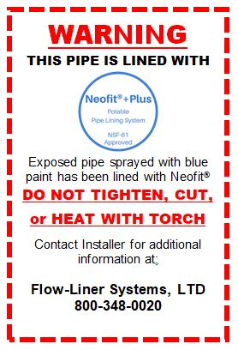
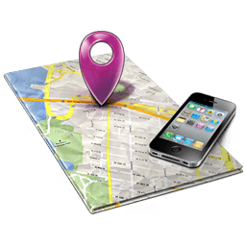
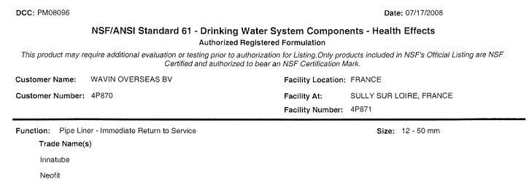
Neofit After Installation
Warning Labels
Tag your lines after installation
Blue Paint Indicators
Immediate Return to Service- NSF
Add Records to GIS System? (e.g. Length of install, date of install, installer name, presence of bends, CCTV inspections?)
Frozen Line
Thawing of frozen liner
Damaged Line
Repairing damaged liner
Removing damaged liner

Slide 30
Neofit After Installation
Frozen lines – Neofit Testing
Figure 1 depicts a ¾” copper pipe lined with Neofit and frozen for 48hrs. Shows no signs of damage to pipe.
Figure 2 depicts ¾” copper pipe not lined with Neofit and frozen for 48hrs. Notice the split in the copper pipe near the fitting.
Figure 3 depicts ¾” PEX tubing with an approx ¼” hole drilled in it and then lined with Neofit. Pipe frozen for 48 hrs. Shows no signs of damage to pipe or any breach where hole is drilled
Conclusion: Pipes lined with Neofit were not damaged when frozen. Neofit added strength to host pipe and protected from splitting as show in figure 2
Damaged Line after installation? Two options:
Repairing damaged liner
Removing damaged liner
1
2
3

Slide 31
Neofit Comparison
Pull-In-Place
Access at Both Ends
Will Require Excavation or Demolition
Larger Excavation Pits Necessary
Much More Invasive than Neofit
New Pipe Risks Damage During Process
Open-Cut Excavation
Extremely Invasive
Damaging
Surrounding Utilities
Landscaping, Lawns, Driveway, Sidewalk, Road
Lead Service Line replacement (Flint)
Horizontal Boring
Pull-in-Place Installation
Neofit Installation (Louisville)

Slide 32
Neofit Costs
Average Lead Line Replacement according to WRF
$2,000-$8,000
MLIVE Flint Michigan, 2016
“A pilot study done for the state, to get a handle on the challenge ahead, estimated an average price of $7,500 per house to change water lines.”
Milwaukee Journal Sentinel, 2017
“. . . the city projected costs for each line to be as high as $9,000.”
CBS Chicago, 2016
“Plumbers’ estimates to replace the old lead lines at the Berry home run from $15,000 to $18,000. That is in addition to $3,500 for city permits to perform the work.

Slide 33
Neofit Costs
Average savings estimated at 35-45%
As depth or length of line increases, so does your savings
Time savings
City of Flint, MI estimates:
Best 5hrs (little hard surface excavation, half lead, < 40ft, < 1”, shallow)
Worst 15hrs (hard surface excavation, full lead, > 60ft, >1”, deep)
Average Neofit Installation 2.5hrs regardless of depth
More Savings – Become a Neofit Certified Installer
No Licensing Fee

Slide 34
Neofit Dealer to Installer Warranty
Neofit+Plus liner has a standard ten-year limited warranty from the distributor/manufacturer. For municipal projects, Neofit+Plus liner has a 25 year limited warranty.

Slide 35
Q&A Session
Thank you!

Slide 36
Appendix 1 – The Neofit+Plus System for Installers
Neofit®+ Plus Unit Specifications
For Pipe Sizes: -- 1/2”- 2” ID (U.S.)
For Pipe Types: -- Lead, Plastic, Copper, Galvanized
Operation: -- Automated Controls
Electrical: -- 208V; 60HZ; 3PH
Hot Water Unit: -- Auxiliary Diesel Fired
Weight: -- 310lbs
Dimensions: -- 36” H x 19” W x 40” L
Hoses: -- 25’ Sections w Quick Connect Ends (8)
Lining Capacity: -- Up to 300 lineal feet
Includes: Hoses, Quick Connect Adapters, Hot Water Unit, Air Gun, Coil Dispenser
U.S. Patent No. 8,807,171

Slide 37
Appendix 1 – The Neofit+Plus System for Installers
Neofit®+ Plus Standard Installation Package for ½” – 1” ID pipes
Designed for 7mm and 10mm liner installation and includes:
300 foam cleaning pigs
1 installation adapter
50 O-rings
15 stiffeners
1 set of pulling heads
Neofit®+ Plus Standard Installation Package for 1-¼”– 2” ID pipes
Designed for 15mm and 20mm liner installation and includes:
300 foam cleaning pigs
1 installation adapter
50 O-rings
15 stiffeners
1 set of pulling heads
U.S. Patent No. 8,807,171

Slide 38
Appendix 2 – European Re-Testing Further Explained
At face value it sounds like a simple request but in reality it is nothing of the kind. I hope the following points will help better explain the situation:
1. Running water from a tap/faucet in the house does not give a meaningful result regarding the condition of the Neofit-lined service as false positive results can readily happen. Metal pipes and fittings both upstream and downstream contribute to any reading. Brass fittings and soldered connections are common, and even today a significant number of homes have lead plumbing within the building downstream of the meter.
2. There are no offline test/monitor sites in Europe which can be readily accessed without supply disruption to properties
3. To properly test would involve turning off the supply, breaking connections (itself disruptive to any test result) extended flushing then re-connection. In the event of an anomalous result (like one line in Louisville where a false positive reading was caused by an old brass fitting) this would require further investigation and repeating the whole procedure. No homeowner is going to sign up for this without a very good reason (like there is already a suspicion of lead contamination in his water supply)
4. Any site being opened like this would require excavation and works on both public and private land and require the co-operation of at least 3-4 different individuals or companies/agencies – private homeowner / private water company / local municipality / highways agency, followed by making good to the satisfaction of all parties. The chances of getting such across the board agreement for a non-urgent or non-mandated matter are very slim.
With this in mind it is not at all surprising that when we approached one of the French Water Companies, which are privately owned, we got a rather negative and alarmed reaction. Only a known issue of direct significance to their paying customers could justify taking these steps.
We hope this better explains the position on this subject and also why we are stressing so heavily on the Louisville trial. This was deliberately set up so that there would be the possibility to make future tests without all the drawbacks mentioned above which apply at every live installation. It is the only location worldwide where these kind of ‘clean’ and impartial measurements can be made. We have excellent test data at 8 years old which is already long-term compared to data on other pipeline materials and systems.
In the meantime we are continuing to scour the archives for before/after test reports on early installations. The issue here is that it is so long ago that such reports were considered as being relevant (and often not required even then if a national Certification was in place). If we find anything more from this search you will be informed immediately, although so far we only located the Wessex Water letter from this exercise.
Hope this better explains our earlier comments on this subject and look forward to your feedback. We remain 100% committed to making all reasonable information and data available.

Slide 39
Appendix 3 – Lab Testing, Approvals
NSF International WRc
Oct 2016, Test Report, BS 6920
Suitability of non-metallic products for use in contact with water intended for human consumption with regard to their effect on the quality of the water
May 2008, May 2009, April 2010, April 2014, Test Report, NSF/ANSI 61
Water Quality Association, NSF 61 Standard, annually since
Australian Water Quality Centre
June 2003, Test Report, AS/NZS 4020:2002
Testing of Products for use in Contact with Drinking Water
US Approvals
State of Ohio
City of Columbus, OH
Muskingum County, OH
Washington Suburban Sanitary Commission, MD
Providence Water, RI
State of Wisconsin

Slide 40
Appendix 4 – Tim Ball Install Info
Service Number | Date Lined | Neofit Machine Started | Cool Down Completed | Footage Lined
1 | 10/13/09 | 10:12 | 10:45 | 51
2 | 10/15/09 | 09:22 | 09:52 | 50
3 | 10/15/09 | 10:42 | 10:55 | 50
4 | 10/15/09 | 11:45 | 11:57 | 50
5 | 10/15/09 | 13:04 | 13:29 | 50
6 | 10/16/09 | 11:11 | 11:30 | 49
7 | 10/16/09 | 12:19 | 12:31 | 51
8 | 11/16/09 | 10:04 | 10:26 | 49
9 | 11/16/09 | 11:32 | 11:46 | 50
10 | 11/16/09 | 12:48 | 13:05 | 49
11 | 11/16/09 | 13:55 | 14:09 | 62
12 | 11/16/09 | 14:53 | 15:09 | 51
13 | 11/16/09 | 16:17 | 16:31 | 52
14 | 11/19/09 | 11:25 | 11:44 | 52
15 | 11/19/09 | 12:33 | 12:47 | 52
16 | 11/19/09 | 13:35 | 13:50 | 52
17 | 11/19/09 | 15:07 | 15:23 | 51
18 | 11/19/09 | 16:10 | 16:25 | 50
Tim Ball, Infrastructure Renewal Services, 2009
Circulation & Expansion Range:
12-33 minutes
Average: 18mins
Range of Lengths:
49-62ft Average: 51ft
Infrastructure Renewal Services, Tim Ball - Case Data

